Slide 1
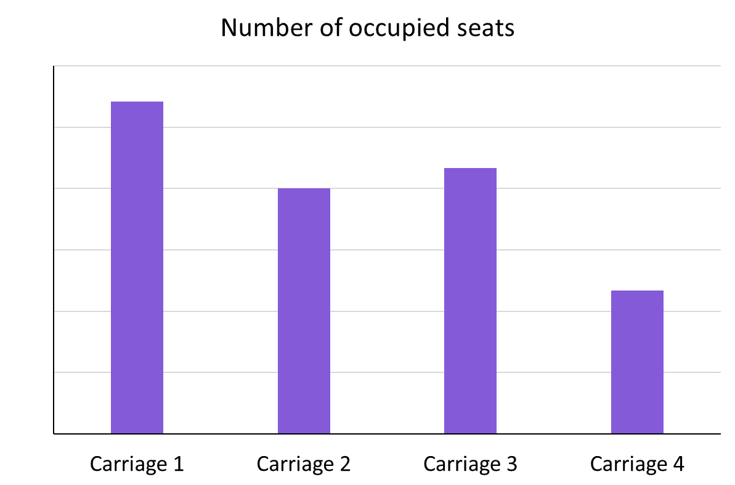
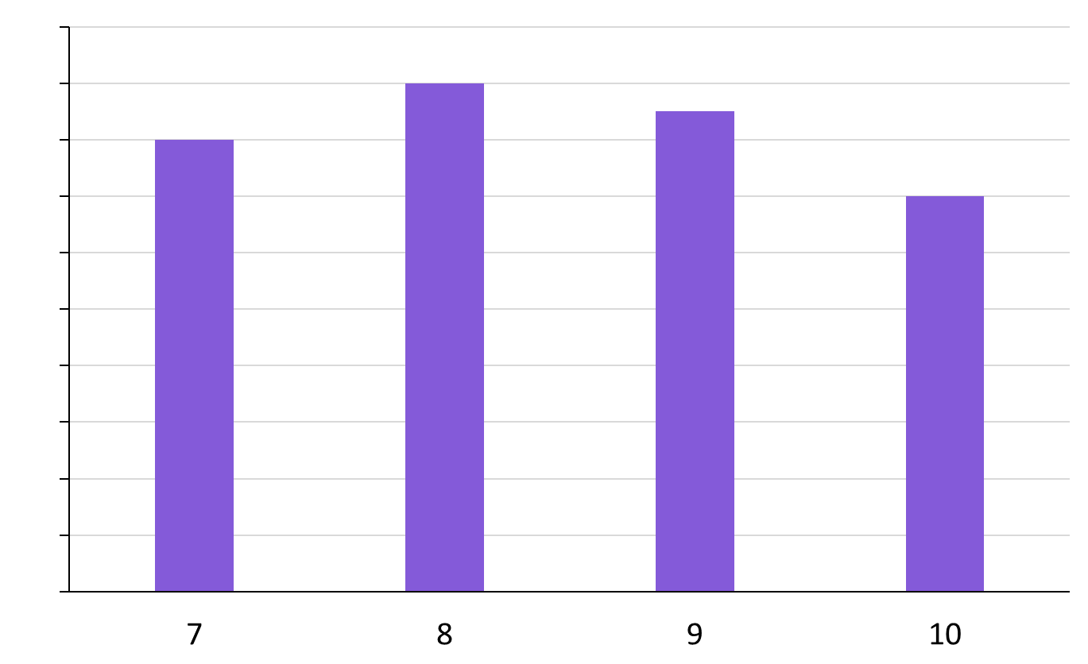
Securing constructing bar charts by hand
Task A: Constructing and interpreting bar charts
Complete the vertical scale.
72
Frequency
60
48
36
24
12
Complete the frequency table and bar chart.
sweets per pack | frequency
7 | 16
8 | 18
9 | 17
10 | 14
20
18
Frequency
16
14
12
10
8
6
4
2
Sweets per pack

Slide 2
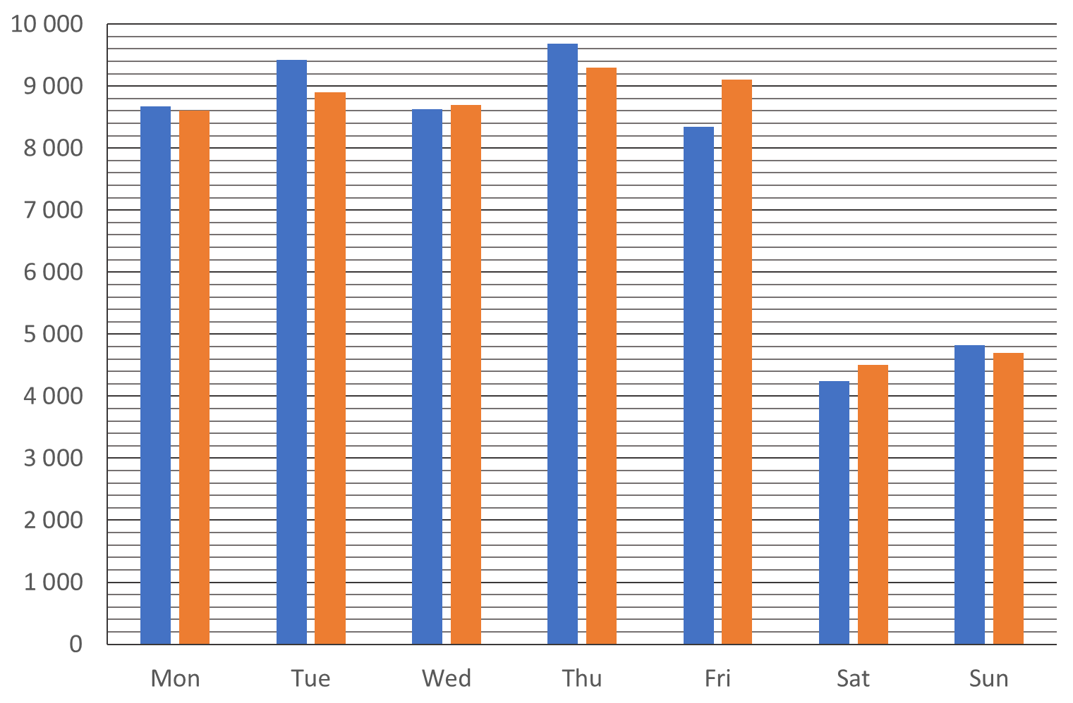
Securing constructing bar charts by hand
Task B: Using bar charts in a data investigation
Decide whether each data set should be ordered or not.
Colours of karate belts
Animals at a zoo
Types of pen
Movie genres
Clothing sizes
Ordered as there is a ranking system.
Not ordered
Not ordered
Not ordered
Ordered e.g. XS, S, M, L, XL, XXL
Jacob wants to see if there is any trend to his step count. He collects data over a two week period. Week one is displayed,
add week two to the bar chart.
Frequency
Week 2
Mon | 8 600
Tue | 8 900
Wed | 8 700
Thu | 9 300
Fri | 9 100
Sat | 4 500
Sun | 4 700
Days
b) What comments can you make regarding Jacob’s daily step count? Justify your comments.
You may have responded with:
His daily step count is lower at the weekend. This may be because he isn’t walking around a school building.
The daily step counts are similar between the two weeks, this may be due to him following the same timetable during the week and the same hobbies at the weekend.
Mathematics in Education and Industry.
v2.2

